Slide 1

CSE 3521: Introduction to Artificial Intelligence
[Many slides are adapted from the UC Berkeley. CS188 Intro to AI at UC Berkeley and previous CSE 3521 course at OSU.]

Slide 2

Machine learning
A set of methods that can automatically detect patterns in data, and then use the uncovered patterns to predict future data, or to perform other kinds of decision making under uncertainty
Kevin Murphy. Machine learning: a probabilistic perspective. The MIT Press
Learning from Data
Algorithm
Evaluation
Data
Linear regression
SSE
$$\left\{\left(x_{1},y_{1}\right),…,(x_{N},y_{N})\right\}$$
Least square (closed-form)

Slide 3


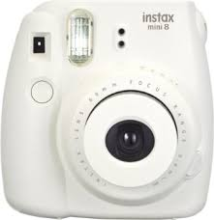
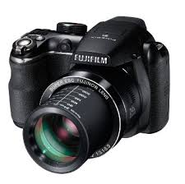
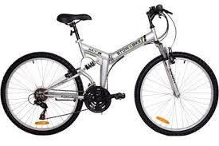
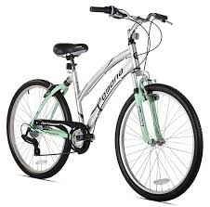

Supervised learning
Data type: $\left\{\left(x_{1},y_{1}\right),…,(x_{N},y_{N})\right\}$
Goal: Build a model so that given a future data instance $x$, it can tell the label $y$
Example: Nearest neighbors
The “label” in $\left\{\left(x_{1},y_{1}\right),…,(x_{N},y_{N})\right\}$provides supervision of how to give each data instance a label
The label can be “numerical” (regression) or “categorical” (classification)
laptop
laptop
camera
camera
bike
bike

Slide 4
Classification vs. regression
Classification
Supervised learning
Form: Data point → Desired category (integer number index)
Ex: 1: Cat, 2: Dog, 3: Horse, ……, 1000: Car
Regression (curve Fitting)
Supervised learning
Form: Data point → Desired real number (e.g., price, chance, etc.)
Machine learning: capture patterns from training data
that can be generalized to future data

Slide 5
Classification vs. regression: training data
Regression (bus ticket):
From x (distance), predict y (price)
Classification (car buying company):
From x (year, miles), predict y (buy or not)
y: price
x[2]: miles
y:
Buy
Not
x: distance
x[1]: year in use

Slide 6
Classification vs. regression: find patterns
Regression (bus ticket):
From x (distance), predict y (price)
Classification (car buying company):
From x (year, miles), predict y (buy or not)
y: price
x[2]: miles
Linear relationship
Linear boundary
y:
Buy
Not
x: distance
x[1]: year in use

Slide 7
Classification vs. regression: generalization
Regression (bus ticket):
From x (distance), predict y (price)
Classification (car buying company):
From x (year, miles), predict y (buy or not)
y: price
x[2]: miles
Linear relationship
Linear boundary
y:
Buy
Not
x: distance
x[1]: year in use

Slide 8
Classification vs. regression: generalization?
Regression (bus ticket):
From x (distance), predict y (price)
Classification (car buying company):
From x (year, miles), predict y (buy or not)
y: price
x[2]: miles
Linear relationship
Linear boundary
y:
Buy
Not
?
?
x: distance
x[1]: year in use

Slide 9
Supervised learning: PEAS
Environment:
data distribution (e.g., pictures in the real world)
Agent function (sensor, actuator):
input data:
the model to predict label:
Performance (loss/error) in comparison to the true label $y$:
Classification:
Regression:
“Hat” here refers to the fact that this is a predicted label
$$x$$
$$\hat{y}=f\left(x\right)$$
$$f:𝒳↦𝒴$$
$$1\left[y ≠f\left(x\right)\right]; 1\left[True\right]=1,1\left[False\right]=0$$
Indicator function
$$dis\left(y,f\left(x\right)\right); e.g., {\left(y−f\left(x\right)\right)}^{2} or \left|y−f\left(x\right)\right|$$

Slide 10
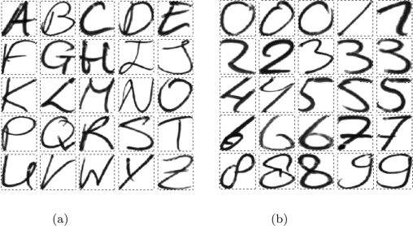
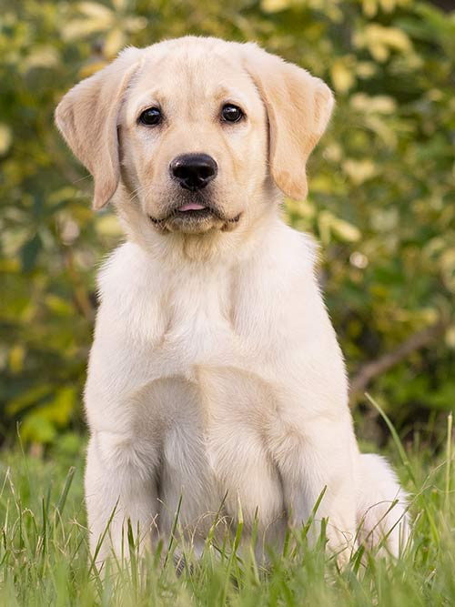

Supervised learning: training data
Training data and test data are assumed to come from the same distribution
Train: real images of certain categories; Test: real images of the same categories (V)
Train: real images; Test: painting images (X)
Train: written digits; Test: written characters (X)
More discussions in later lectures!

Slide 11


Machine learning: training vs. testing
Patterns learned from the training data should be applicable for test data
$$D_{train}=\left\{\left(x_{1},y_{1}\right),…,(x_{N},y_{N})\right\}$$
$$D_{test}=\left\{\left(x_{1},y_{N+1}\right),…,(x_{N},y_{N+M})\right\}$$
y
Choosing a more complicated pattern type does not necessarily lead to lower test errors!
In finding patterns, we only see training data!
x

Slide 12



Machine learning: parameter estimation
Pick a pattern/model type (e.g., linear curves or nonlinear curves)
Pick an error function (e.g., SSE)
Minimize the error on the test data
How do we know if the learned model can be applicable to the test data?
Learning theory
Rule of thumb: more training data, more applicable!
How to choose the model type?
Save some training data as “pseudo” test data!
$$\left\{\left(x_{1},y_{1}\right),…,(x_{N},y_{N})\right\}$$
$$\left\{\left(x_{1},y_{1}\right),…,(x_{N−K},y_{N−K})\right\}$$
$$\left\{\left(x_{N−K+1},y_{N−K+1}\right),…,(x_{N},y_{N})\right\}$$

Slide 13
(Cross) validation
Class index
Base
Instance index
Validation

Slide 14

Cross validation

Slide 15



Supervised Classifier Examples
Decision Tree
Naïve Bayes
Logistic Regression
Support Vector Machine: SVM
K-nearest neighbors: KNN
Boosting/Bagging
$$\left\{\left(x_{1},y_{1}\right),…,(x_{N},y_{N})\right\}$$
$$x$$
$$y$$

